Slide 1
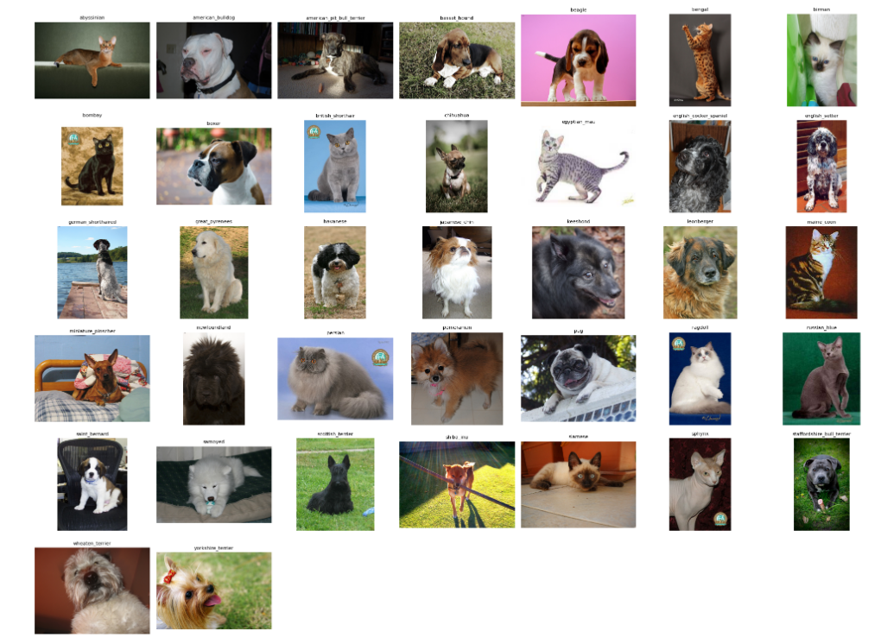
Cat and Dog Breed Classification using Machine Learning
By: Radhika Rani | 102203775

Slide 2
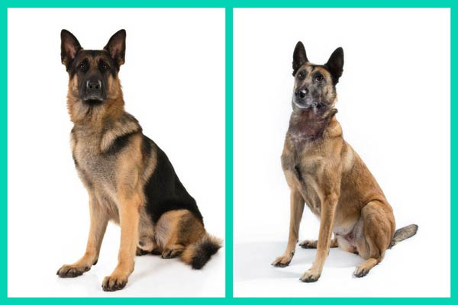
Problem Statement
Identifying animal breeds accurately is challenging due to visual similarity and diverse settings.
An accurate and efficient model is required to streamline this identification process.
Belgian Malinois Dog German Shepherd Dog

Slide 3
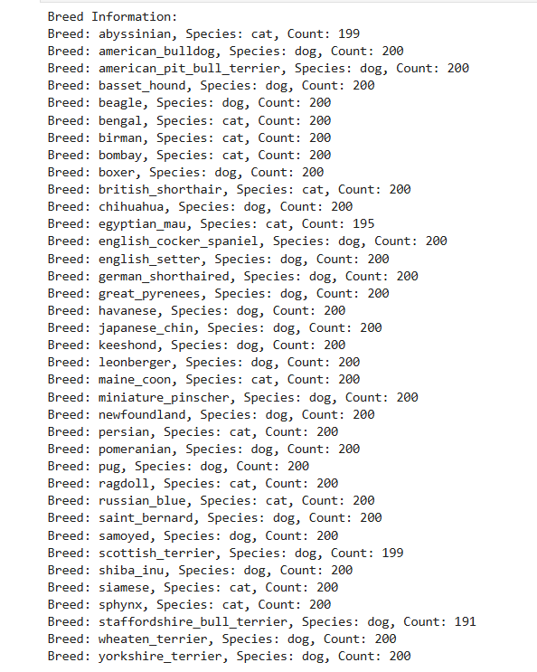
Objective
Build a reliable and efficient model for classifying cat and dog breeds using real- world images.
Achieving high accuracy (at least >0.9) on the given dataset.
Using deep learning to ensure scalability and adaptability.
Comparing different neural network architectures to choose the best model.

Slide 4
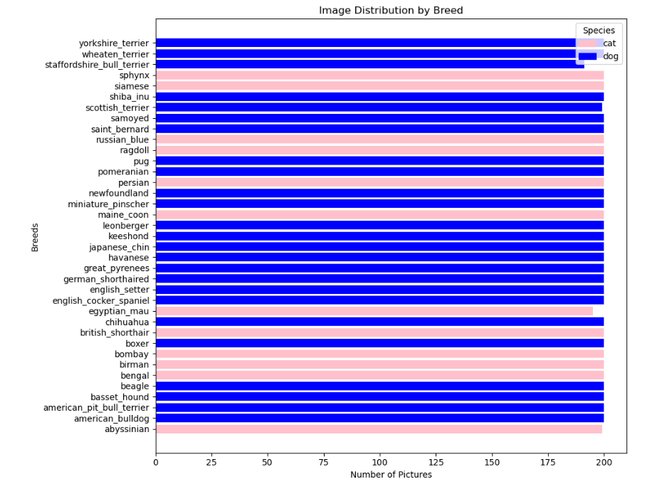
Breaking down our dataset
Total Images: 7390
Images not loading : 6
New Dataset: 7384 images
No. of Classes (Breeds) : 37
Images per class : ~200 (balanced representation)
Dataset consists of real-world images of dogs and cats

Slide 5
Approach
Simple Neural Network Model
1
2
3
4
5
Data Preprocessing
Creating CNN Model
Hyper Parameter Tuning
Model Evaluation
Comparing and Selecting Model
Complex Neural Network Model

Slide 6
01
Data Preprocessing
02
Create CNN Model
Stratified splitting into train and test data and processing train data.
Resizing images.
Retaining color.
Removing background to focus on the subject .
Shuffling images
Simple Neural Network Model: Using custom-built architecture with fewer layers , not applying transfer learning.
Complex Neural Network Model: Based on pre-trained InceptionV3 model using transfer learning.

Slide 7
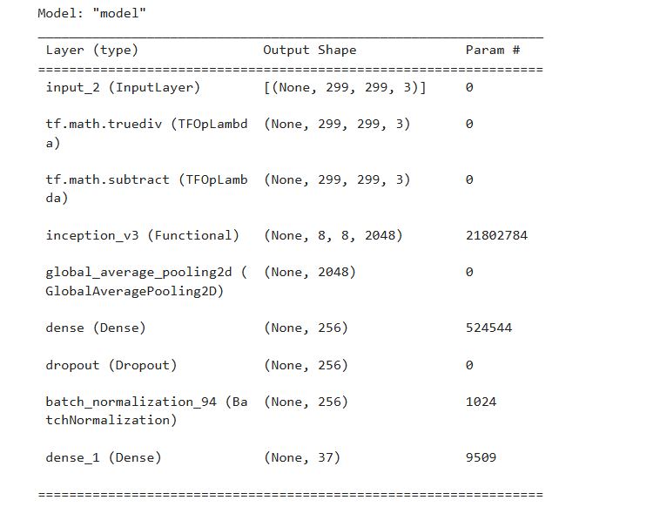
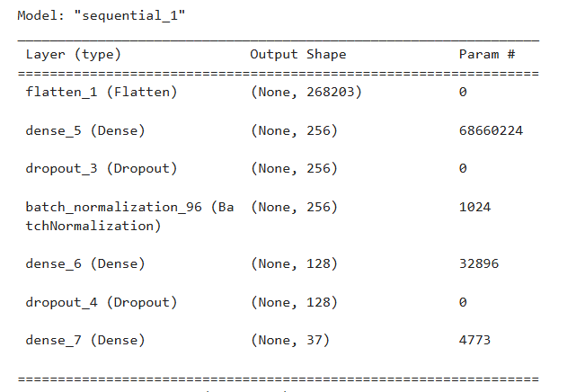
Simple CNN Model
Complex CNN Model

Slide 8
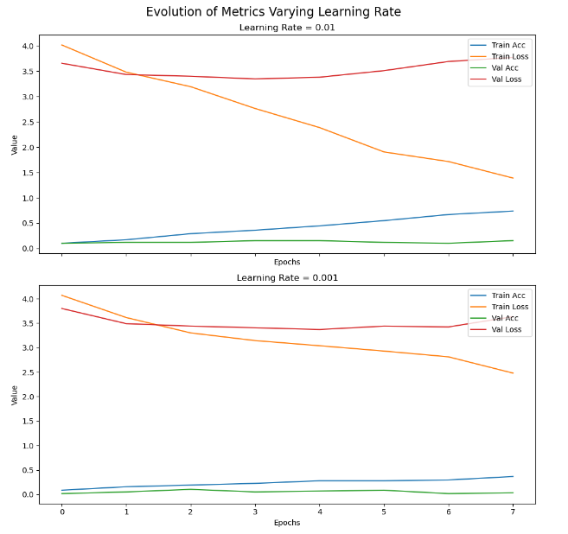
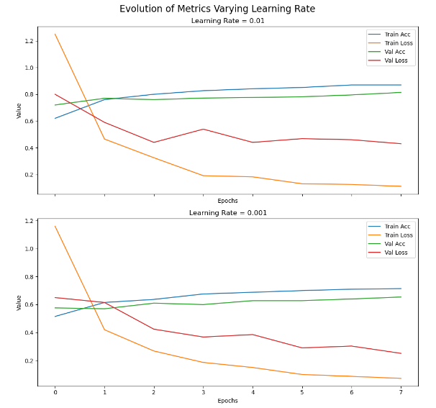
03
Hyper-Parameter Tuning
Learning Rate
Using two values -> 0.01 and 0.001.
For Simple Model ->choosing 0.001 as discrepancy in train and validation loss
For Complex Model-> choosing 0.001 as it converges.

Slide 9
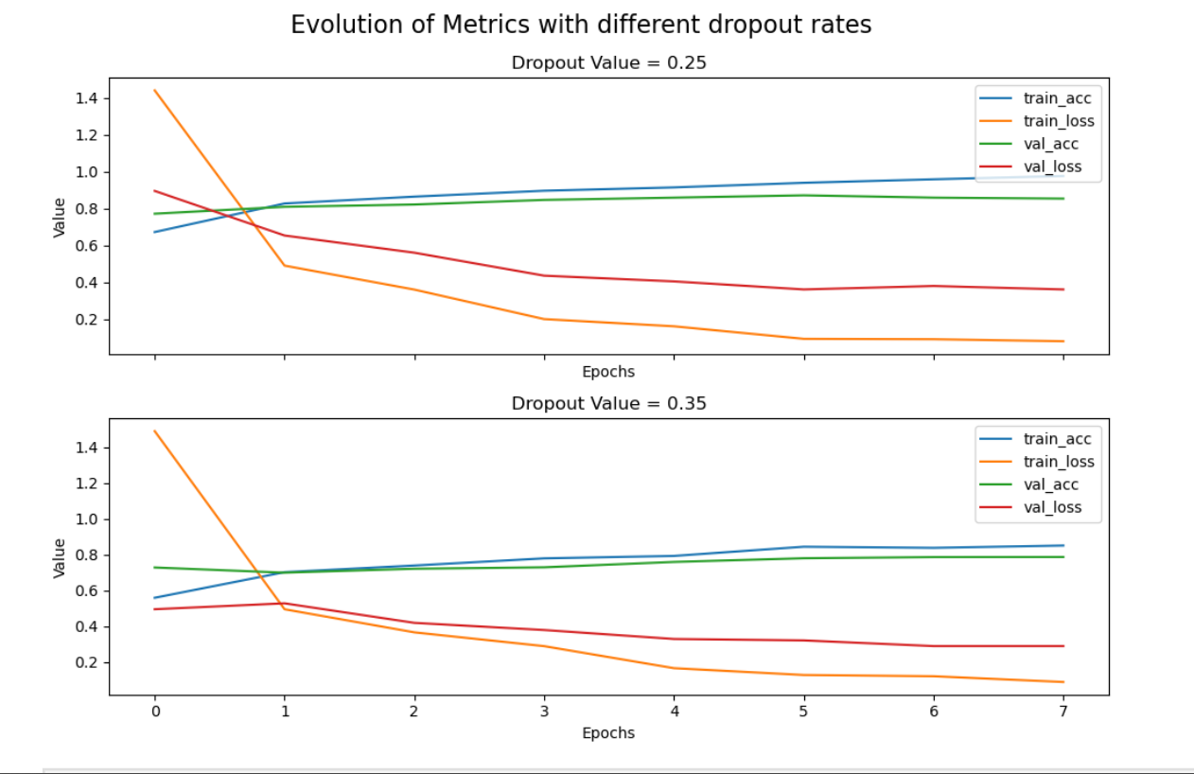
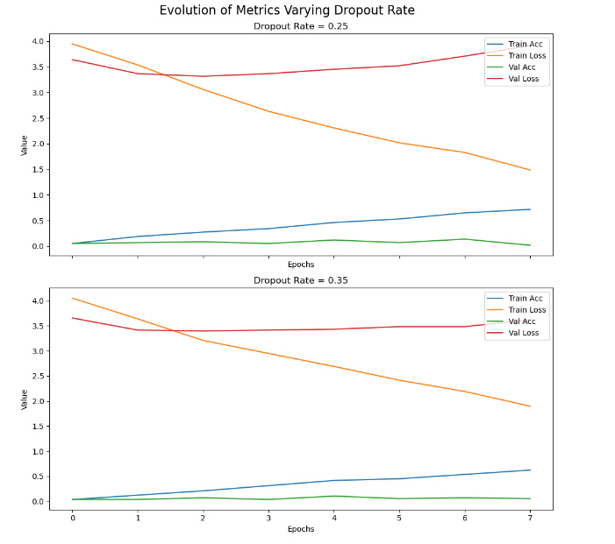
03
Hyper-Parameter Tuning
Dropout Rate
Using two values -> 0.25 & 0.35.
For Simple Model ->choosing 0.35 as less diff. in train and validation loss
For Complex Model-> choosing 0.35 because of better average validation data.

Slide 10
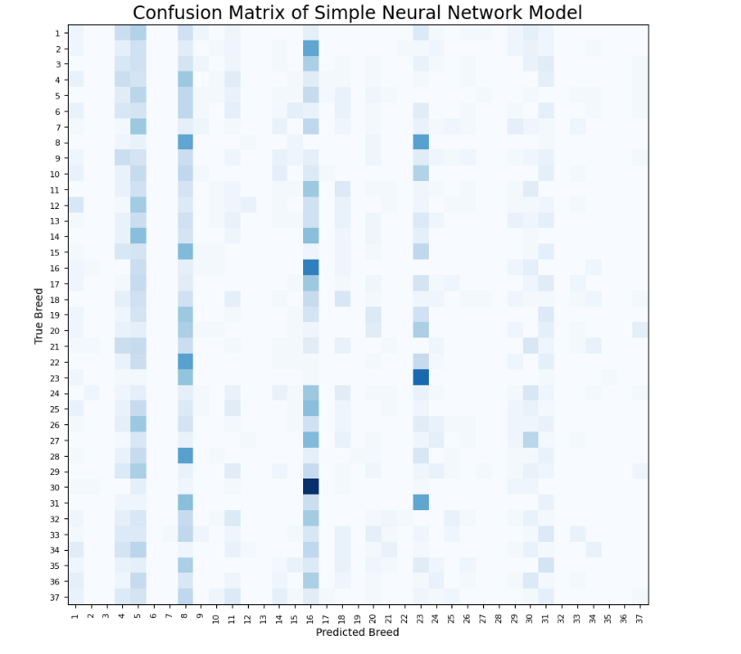
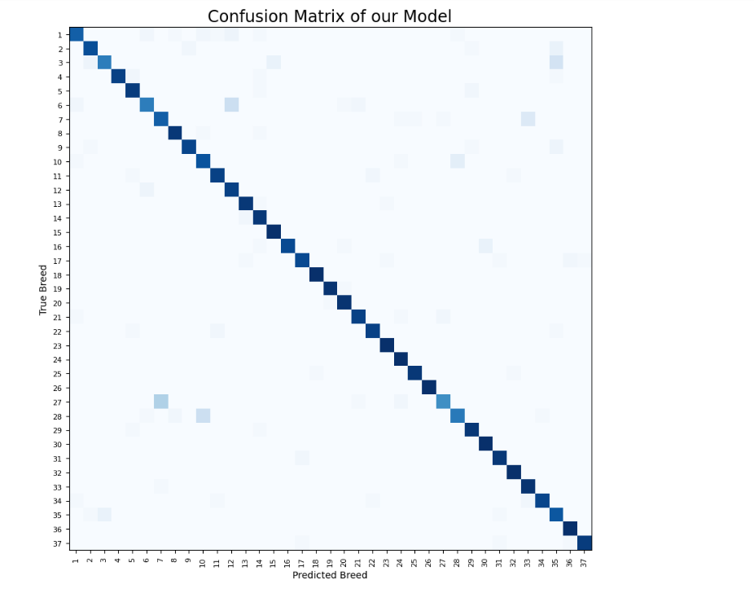
04
Model Evaluation
Simple Model is only predicting few breeds correctly , while Complex Model is not predicting for only few breeds.
Simple CNN Model
Complex CNN Model

Slide 11
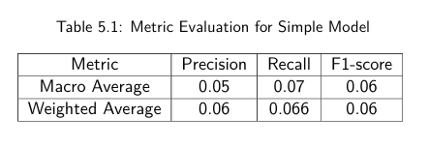
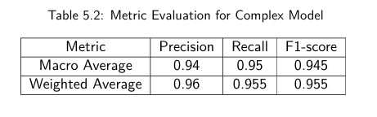
05
Choosing our Model
Below is the classification report summary for both models.
Accuracy = 0.066
Complex CNN Model is the clear winner here giving the accuracy of 95.5% which is far more than 6% as given by Simple Model.
Accuracy = 0.955

Slide 12



Future Work
Implementing model for much larger dataset covering most breeds found.
Experimenting with more hyperparameters like epochs and neurons.
Using advances data augmentation for more variation in data.

Slide 13

Thank You !
Paws-itively Accurate!

